Slide 1

Research Environment at a National Laboratory
Michel Dupuis
Computational and Data-enabled Science & Engineering
Chemical & Biological Engineering Department
University at Buffalo, State University of New York
Buffalo NY 14260
Computational Science: an Industrial Perspective 5/4/2015

Slide 2


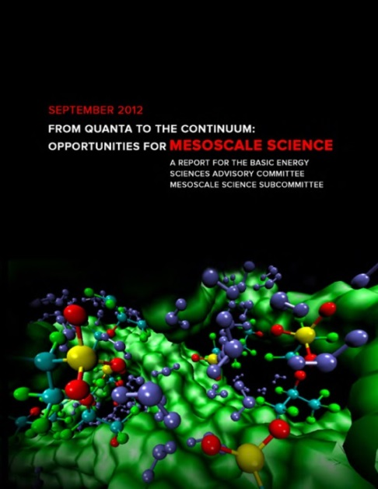
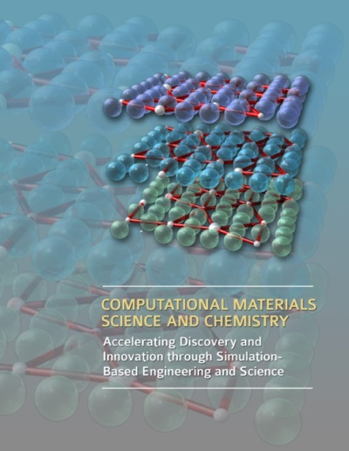
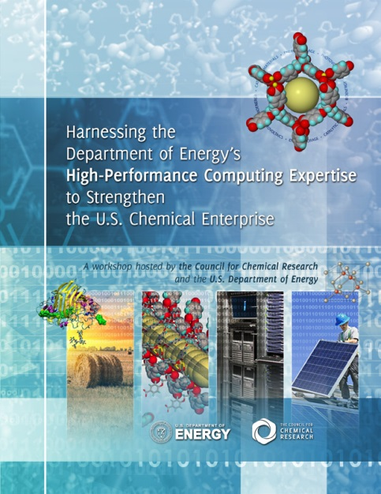
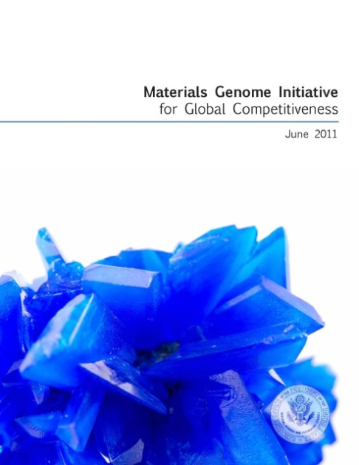
High Performance & Numerically Intensive Computing (HPC)
in my Research
Consistent with UB’s Initiative on “Computational & Data-enabled Science and Engineering” (CDSE)
Well aligned with DOE/BES directions in fundamental sciences:
  “From Quanta to the Continuum: Opportunities for Mesoscale Science” (DOE/BES) (2012)
  “Computational Materials Science and Chemistry: Accelerating Discovery and Innovation Through Simulations” (DOE/BES) (2010)
  “Harnessing the Department of Energy’s High-Performance Computing Expertise to Strengthen the U.S. Chemical Enterprise” (CCR, DOE/BES) (2011)
  “Materials Genome Initiative” (OSTP, DOE/BES) (2011) (batteries, electrolyte, MOF’s,
  organic chromophores for OPV, … )
1972-1976 | SUNY-UB Chem | Created electronic structure program HONDO with Prof. Harry F. King and J.Rys based on a breakthrough approach for calculating electron repulsion integrals. H.F. Schaefer’s top 100 “An incomplete list of landmark papers in ab initio molecular electronic structure methods”
1976-1978 | IBM San Jose | More HONDO – gradients and more
1978-1984 | NRCC - LBNL | NRCC = National Resource for Computation in Chemistry – NSF & DOE – More HONDO – MCSCF – From HONDO to GAMESS – GAMESS to Mark Gordon (Iowa State)
1984-1995 | IBM Kingston | First parallelization of major quantum chemistry code – HONDO on LCAP (Loosely Coupled Array of Processors) – Enrico Clementi – multidisciplinary chemical applications – large scale computations and simulations
1995-now | PNNL | Pacific Northwest National Laboratory – DOE – HPC development: NWChem team – electronic structure program for massively parallel computing – HPC applications: Condensed Phase and Interfacial Molecular Science CPIMS – Catalysis – mesoscale modeling

Slide 3
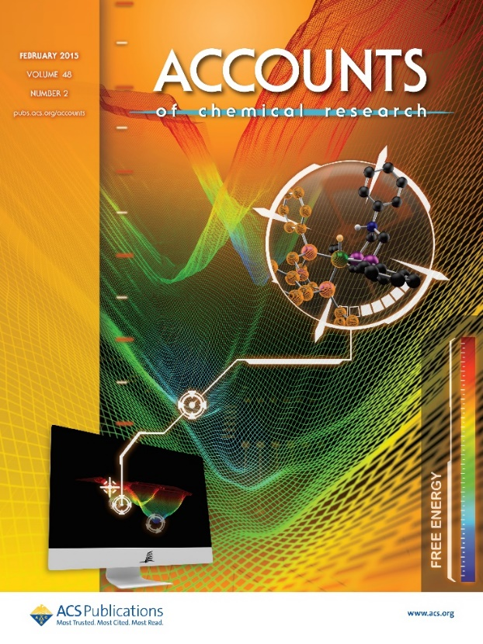
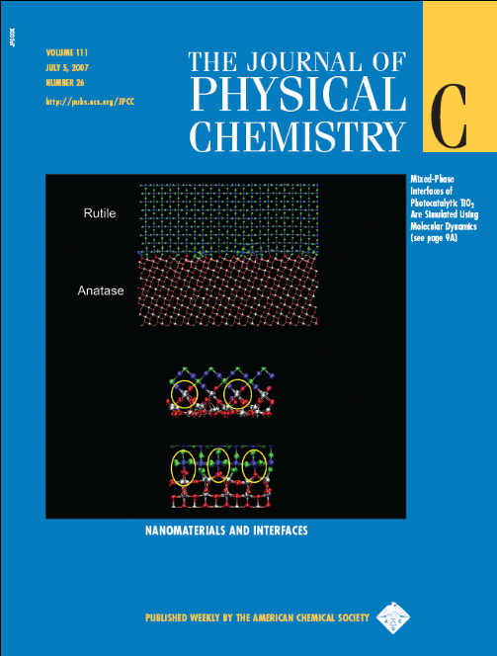
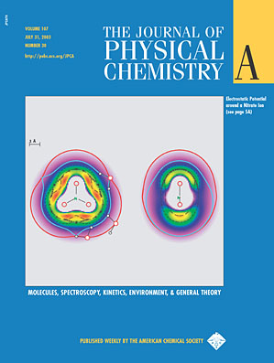
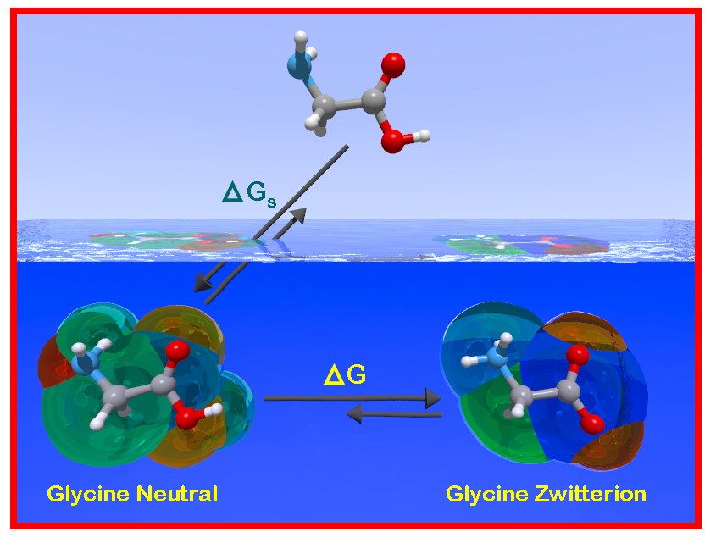

Slide 4
Biggest misconception: NO guaranteed funding! No ‘block’ funding!
Many offices at DOE – BES , BER , EERE , FE , NNSA , NUC
BES = fundamental research
  Chemistry; Materials; Computer Science; Climate Research; Bio-sciences
  Long(er) term funding – competitive – 3 years – peer reviews
  Multi-disciplinary, multi-investigators
  Funding:
    fragmentation ( 2 or 3 projects is best, most often many more)
    need to assemble one’s budget to 100% FTE
    make one’s skills appreciated, to be engaged by other PIs
    publications, presentations, and reputation are the metric
    demonstrate ability to be successful to become PI for DOE
other offices = more applied, more short term

Slide 5
What skills (in particular) got you your job?
Large code development for electronic structure, parallel programming
What was your motive to join your company?
Moved from IBM; unique project NWChem at EMSL (user facility at PNNL)
What is state and scope of computational chemistry outside of graduate school/academia these days?
Very large community of computational chemists (mostly applications except for NWChem)
How much coding do you actually do on daily basis?
Extensive for NWChem group, varying for ‘research groups’
How many people do you write code with?
NWChem has a group of ~ 5, otherwise limited collaborations; often scripts
What version control systems do you generally use?
Linux clusters; fortran; C; python
Are publications important to get a job in a company?
Depends on division/directorate … BES, yes , ~ 4-5 papers a year
Why did you choose to become Professional Editor?
What is your company looking for in an applicant?
Technical expertise;
Potential scientific leader of new projects

Slide 6
How can I increase my value in the job market?
How is computational research in a company different compared to in academia?
National lab= no teaching
BES-funded = fundamental research
Other divisions = from use-inspired to applied and development
Do you have academic freedom in a company?
Not really; “if something is worth doing, somebody must be willing to pay for it)
Within the scope of DOE/BES portfolio (HFI initiative; Comp Mat Sci, … )
Do you regret having left academia?
…. Glad to be back!
If you had to do grad school again, what would you do differently?
Probably would go to academia from the beginning … challenging but rewarding ☺
What is your dream job in the industry?
What are the most attractive employers?
How many people with computational background does your company employ?
Many at PNNL; mostly embedded in experimental projects
Do you get to publish in your company?
Yes, expected for BES-funded projects, less so other projects
Will you be pushed out of science into management eventually?
Not pushed; Lab wants to benefit from your skills; they expect people to step up to leadership.

Slide 7
IBM
IBM-Research Division (Yorktown, Almaden, Zurich)
  use-inspired ‘research’
  linked to product potential and marketing opportunities
Other Divisions
  R & D for products
  emphasis on services

